Slide 1
Airlines Delay
Airline on-time statistics and delay causes
by
Chou Tzu-Jui, Zulqarnain Sourathia, Rakshit Mathur, Salman Shaik, and Nitish Mucherla

Slide 2
Flight Delay
About our Data set
1.9 million Records
29 columns
Year
Month
Day Of Week
Arrival Time…
you get the idea.
Arrival Delays
Departure Delay
CarrierDelay
WeatherDelay…
you get the idea
Time
Flight Info
Delays
Distance
Detination
Airline
flight number
Cancell or not, and more

Slide 3
Some questions to explore
What day of the week tend to have the most departure delay?
Do longer or shorter flights tend to have more cancellations?
Which month tend to have the most cancellations?
Do longer or shorter flights have more Departure Delay ?
Which Carriers have more Cancellations and Cancellation percentage?
Which carriers have More Delay ?

Slide 4
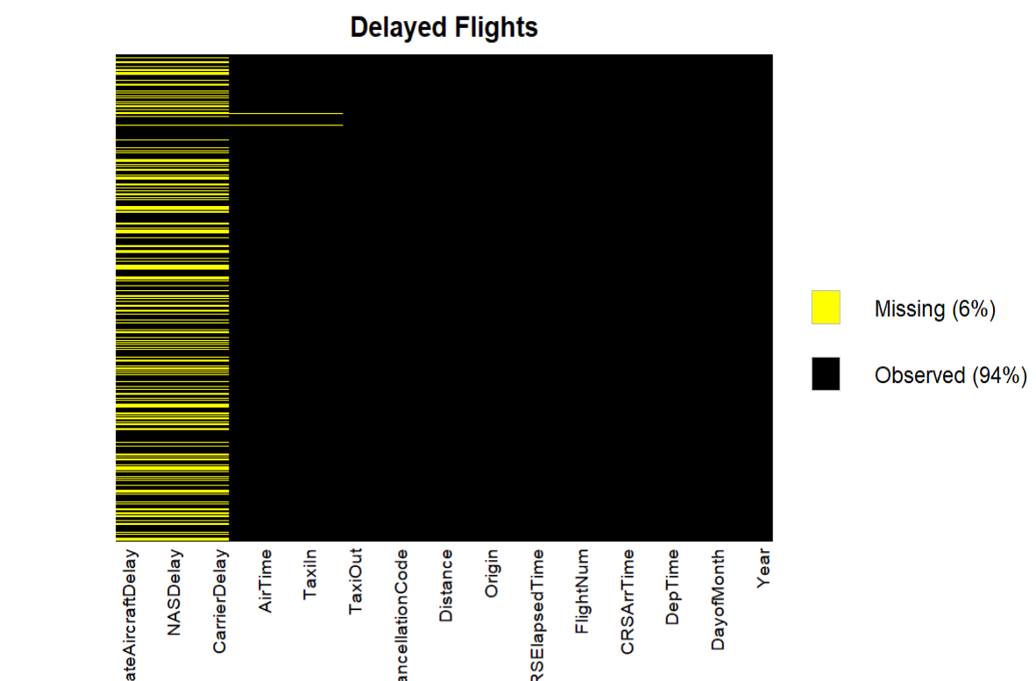
Data Visualizations
MissMap:
Before Cleaning

Slide 5
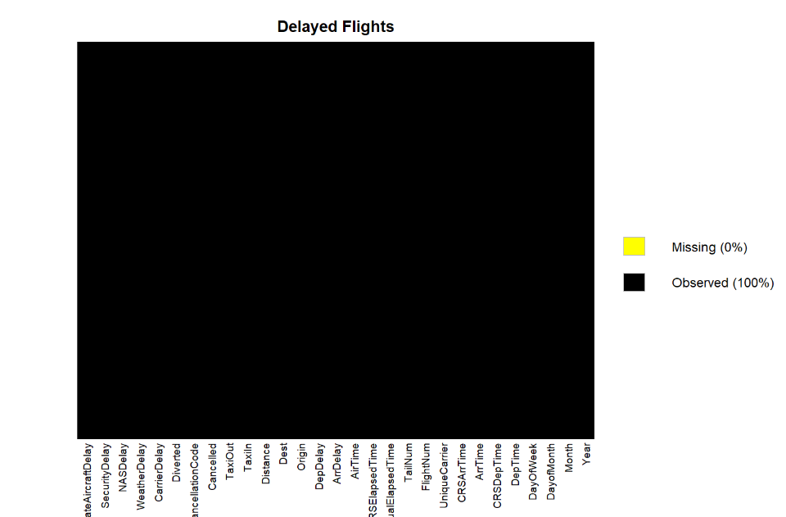
MissMap:
After Cleaning

Slide 6
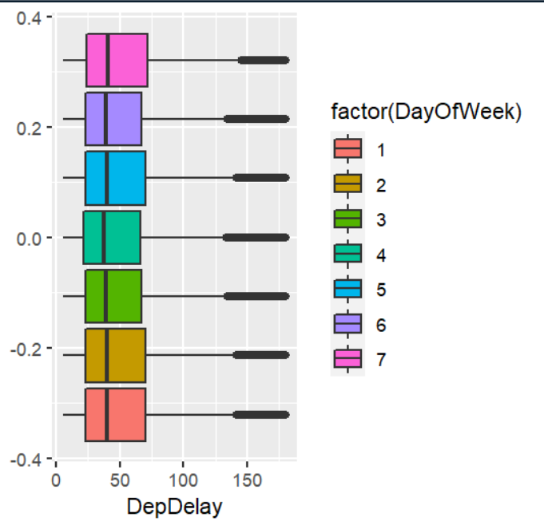
EDA1: what day of the week tend to have the most departure delay?
Comparison: Departure Delay on Each Day of the Week

Slide 7
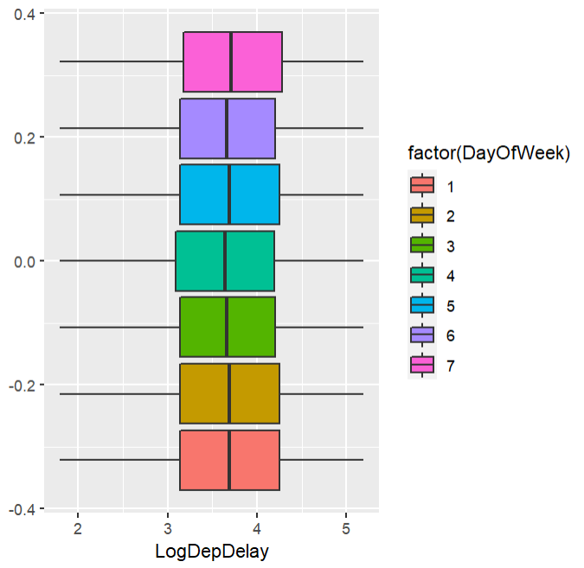
Departure Delay on Each Day of the Week: Logarized

Slide 8
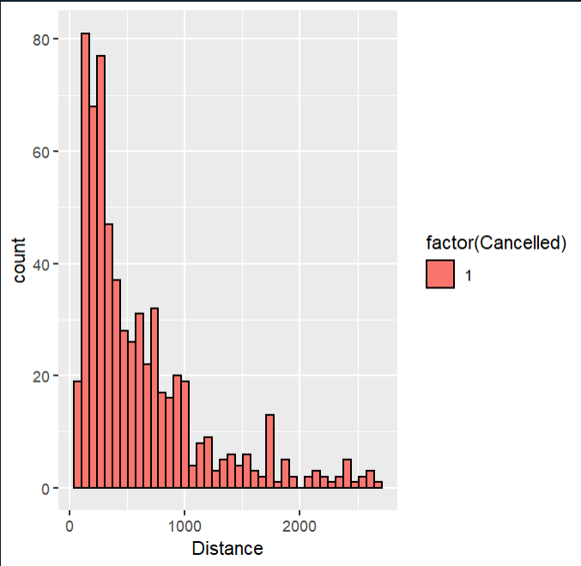
EDA2:Do longer or shorter flights tend to have more cancellations?
The count of cancellations
based upon distance

Slide 9
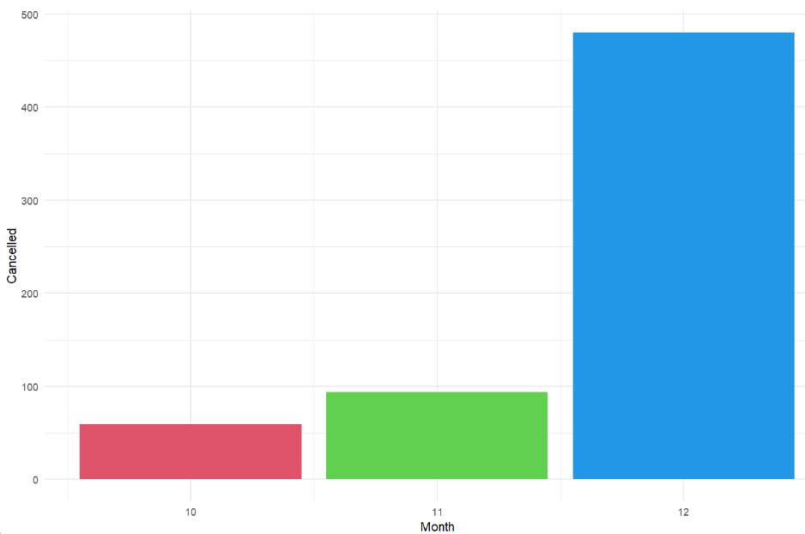
EDA3: Which month tend to have the most cancellations?

Slide 10
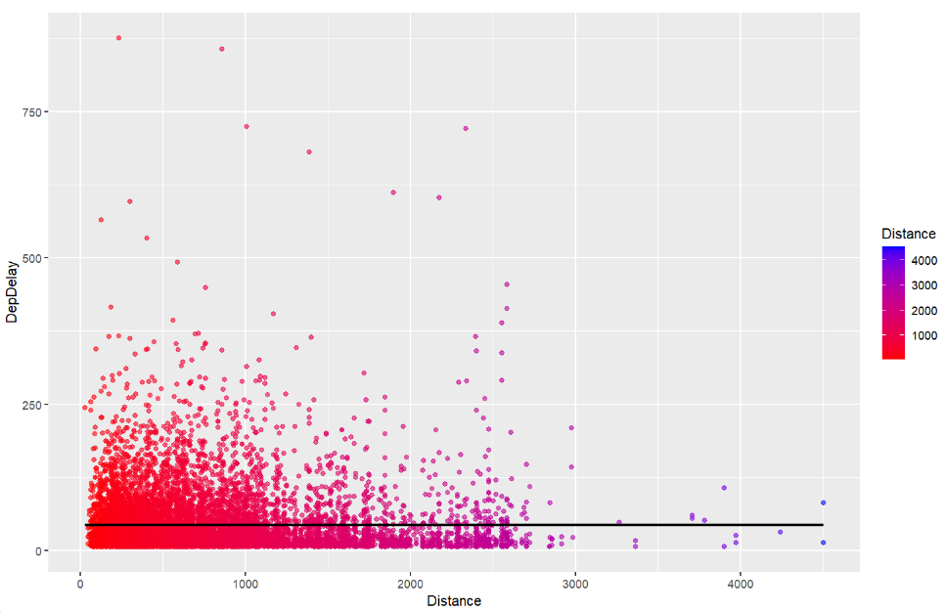
EDA4: Do longer or shorter flights have more Departure Delay ?
Units: Mins/Miles

Slide 11
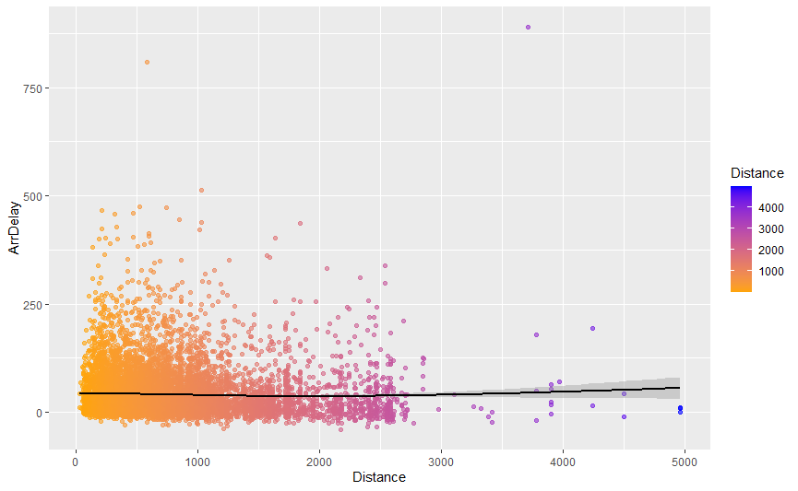
EDA4.1 :Do longer or shorter flights have more Arrival Delay ?

Slide 12
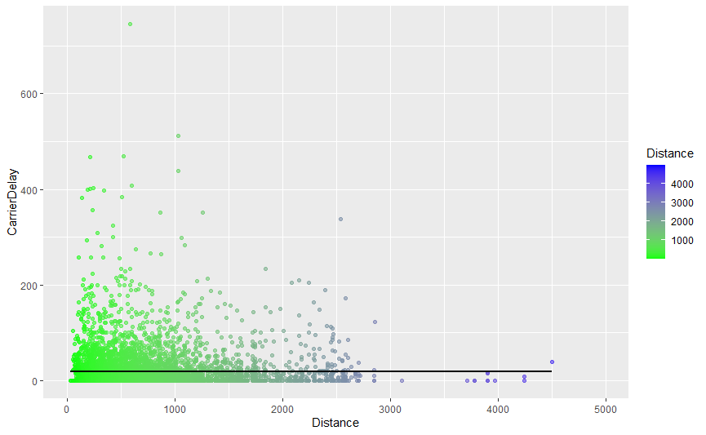
EDA4.2:Do longer or shorter flights have more Carrier Delay ?

Slide 13
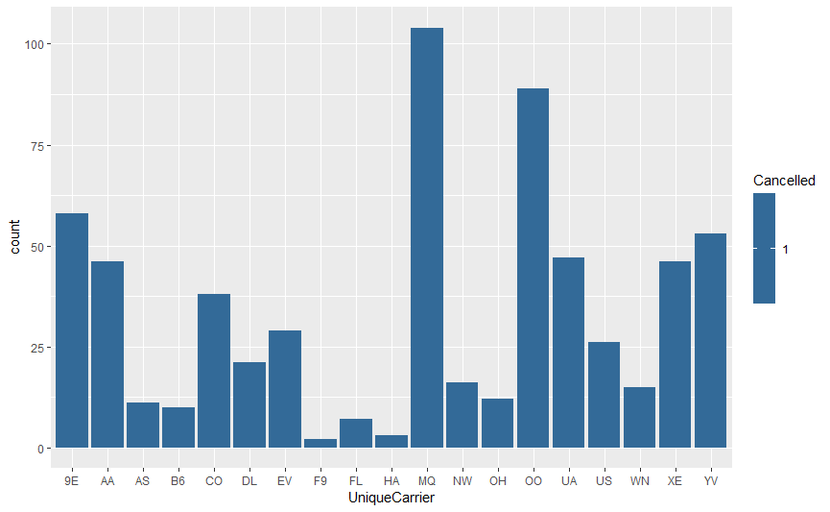
EDA5:Which Carriers have more Cancellations?

Slide 14
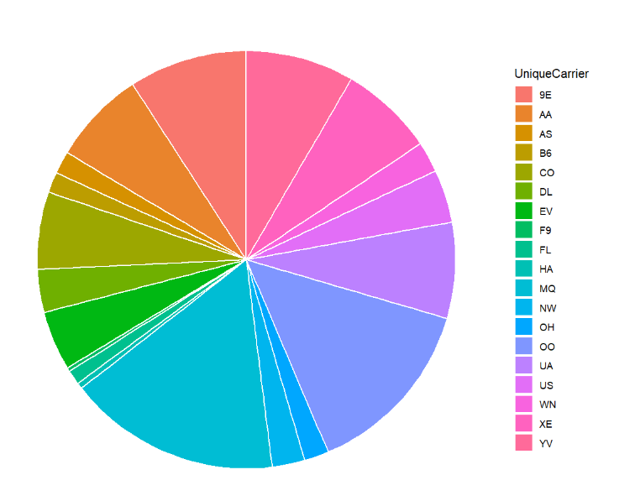
Which carriers have more Cancellations percentage?
9E
YV
UA
OO
MQ

Slide 15
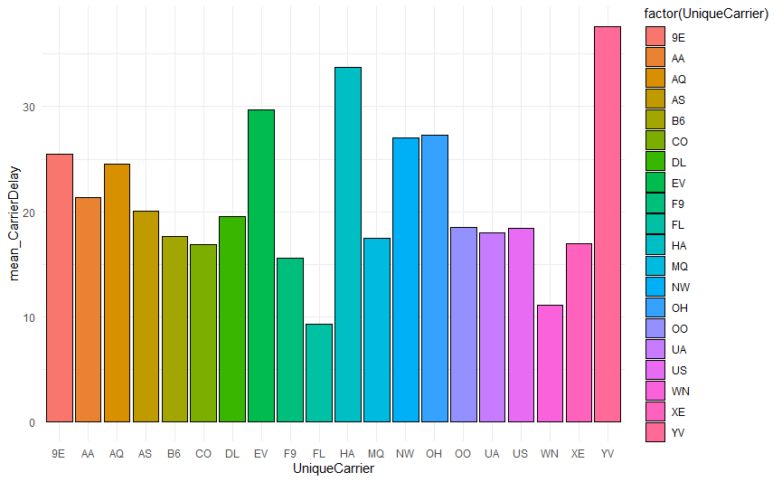
EDA6: Which carriers have More Delay ?

Slide 16
Modeling
CarrierDelay
TaxiOut
Modeling base on training data and predict the outcome base on testing data
Random Sampling: Dataset too large.

Slide 17
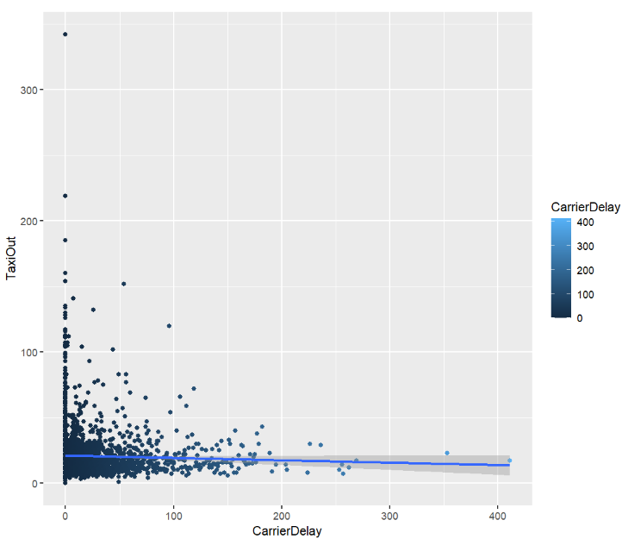
Model results visualization

Slide 18
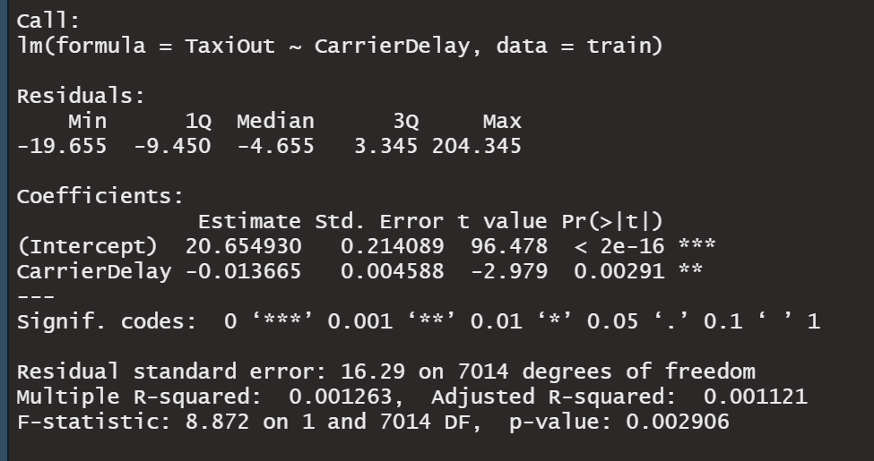

Summary of the model

Slide 19
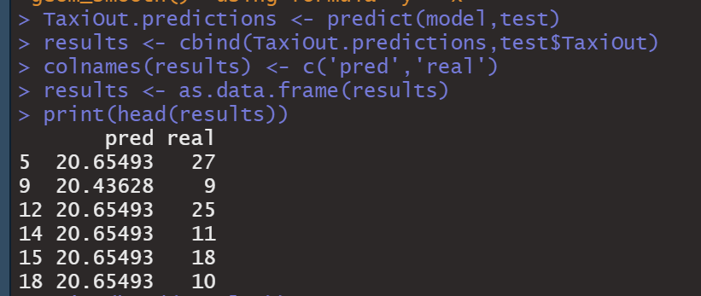

Slide 20
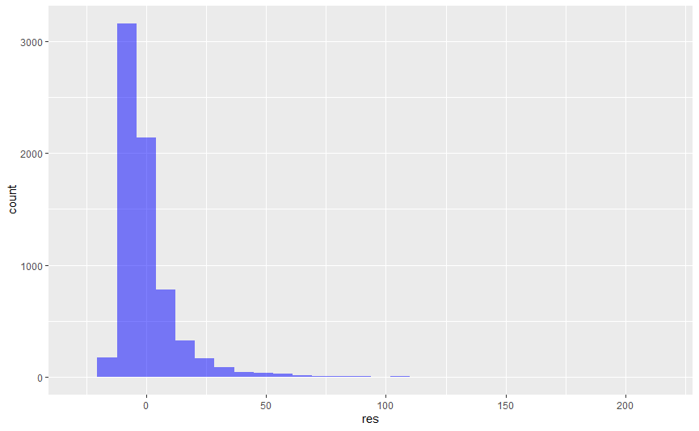
Histogram of Residuals
Let’s just visualize the model by plotting out the residuals,
Residuals are the difference between actual datapoint and predicted linear regression model results. We always try to minimize the residual value.

Slide 21
6. Conclusion
(Intercept) CarrierDelay
20.65493049 -0.01366547
Estimated regression line: µ^{Y/X} = 20.65493049- 0.01366547 (X)
TaxiOut (in minutes) = 20.65493049- 0.01366547 * (CarrierDelay)
The intercept is in the units of minutes and the slope is also in minutes.
There is a slight inverse relationship between Carrier Delay and Taxi Out. The low R2 value and low P value indicate that we can make a model with a clear trend, but the predictions will lack accuracy. This variation could be due to a wide variety of different explanatory variables that were not included in the model.

Slide 22

THANK YOU

